Slide 1
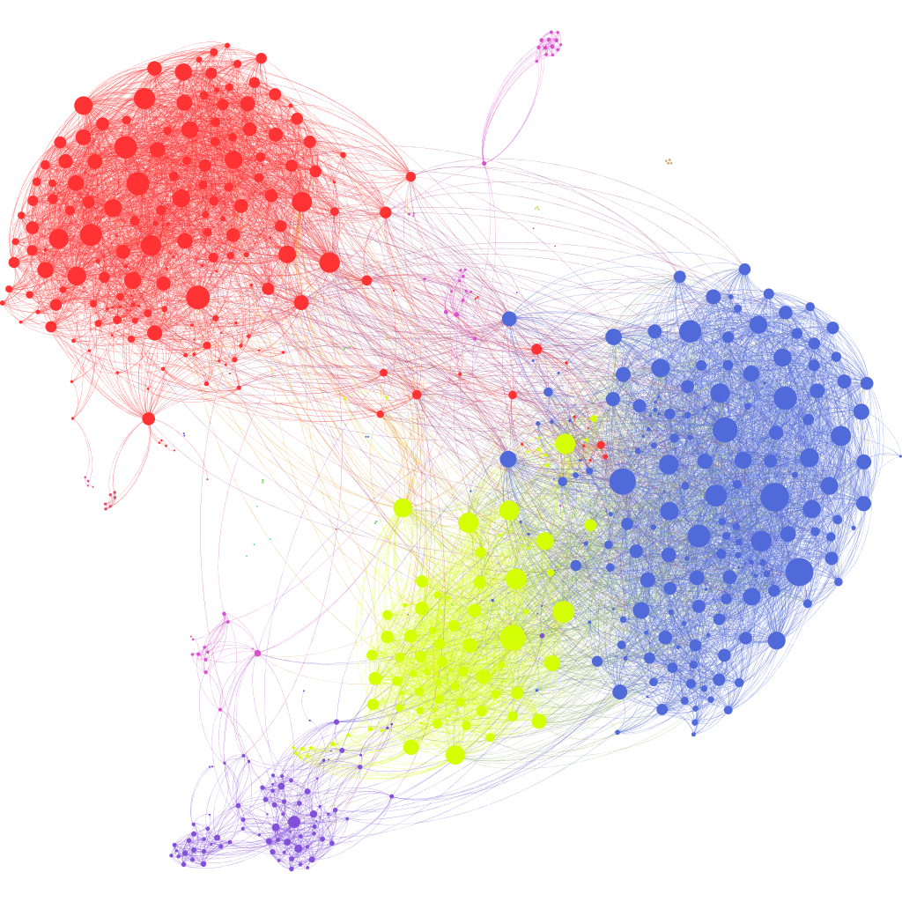
Intro to Transformers
Slides based on stanford 224n

Slide 2
Lecture Plan
The Transformer model
Great results with Transformers
Drawbacks and variants of Transformers
GPT 1-3
Subword tokenization

Slide 3
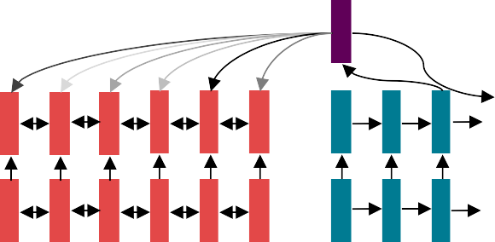


Do we even need recurrence at all?
Abstractly: Attention is a way to pass information from a sequence (𝑥) to a neural network input. (ℎ_{𝑡})
This is also exactly what RNNs are used for – to pass information!
Can we just get rid of the RNN entirely? Maybe attention is just a better way to pass information!
Lots of trial and error
2014-2017ish
Recurrence
2021
??????

Slide 4
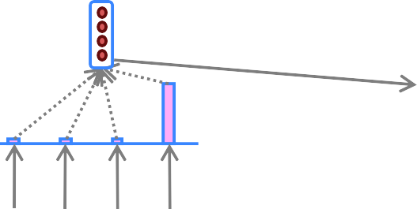
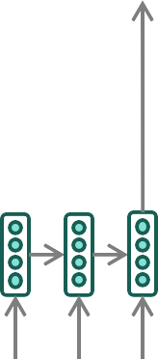
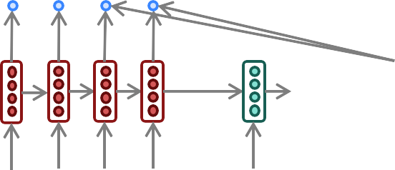
The building block we need: self attention
What we talked about – Cross attention: paying attention to the input x to generate 𝑦_{𝑡}
Attention
output
y
Attention
distribution
Attention
scores
Encoder
RNN
il a
m’ entarté
<START>
he
hit
me
Source sentence (input)
What we need – Self attention: to generate 𝑦_{𝑡}, we need to pay attention to 𝑦_{<𝑡}

Slide 5
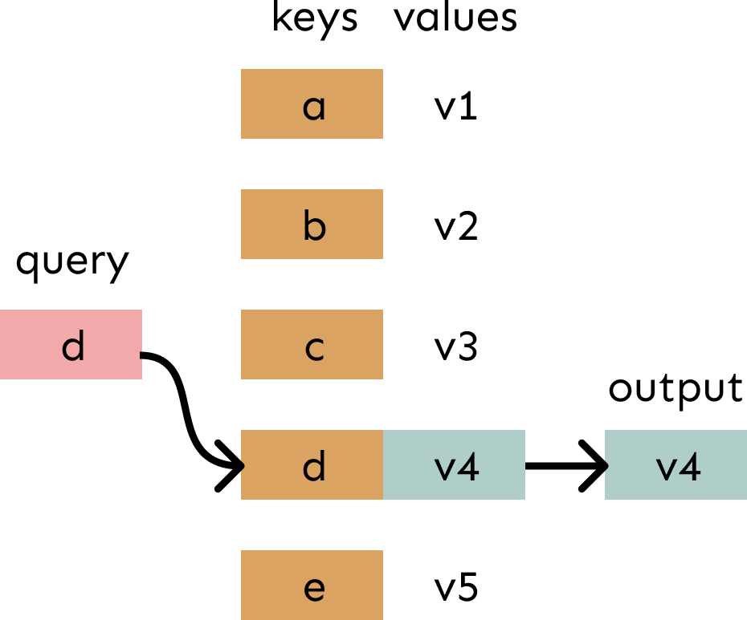
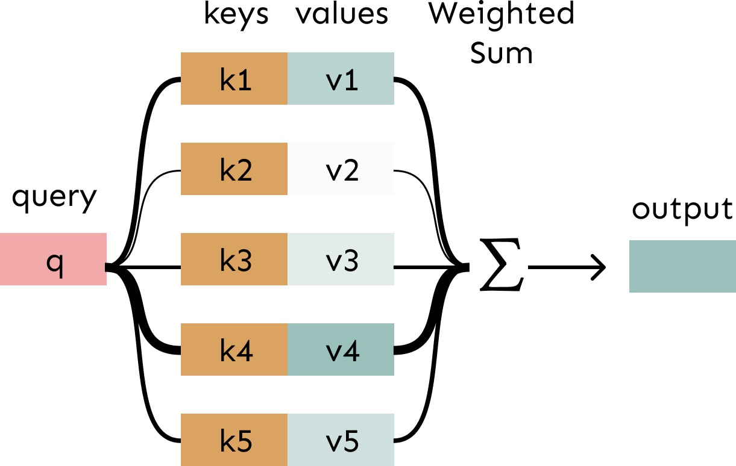
Attention is weighted averaging, which lets you do lookups!
Attention is just a weighted average – this is very powerful if the weights are learned!
In attention, the query matches all keys softly, to a weight between 0 and 1. The keys’ values are multiplied by the weights and summed.
In a lookup table, we have a table of keys that map to values. The query matches one of the keys, returning its value.

Slide 6
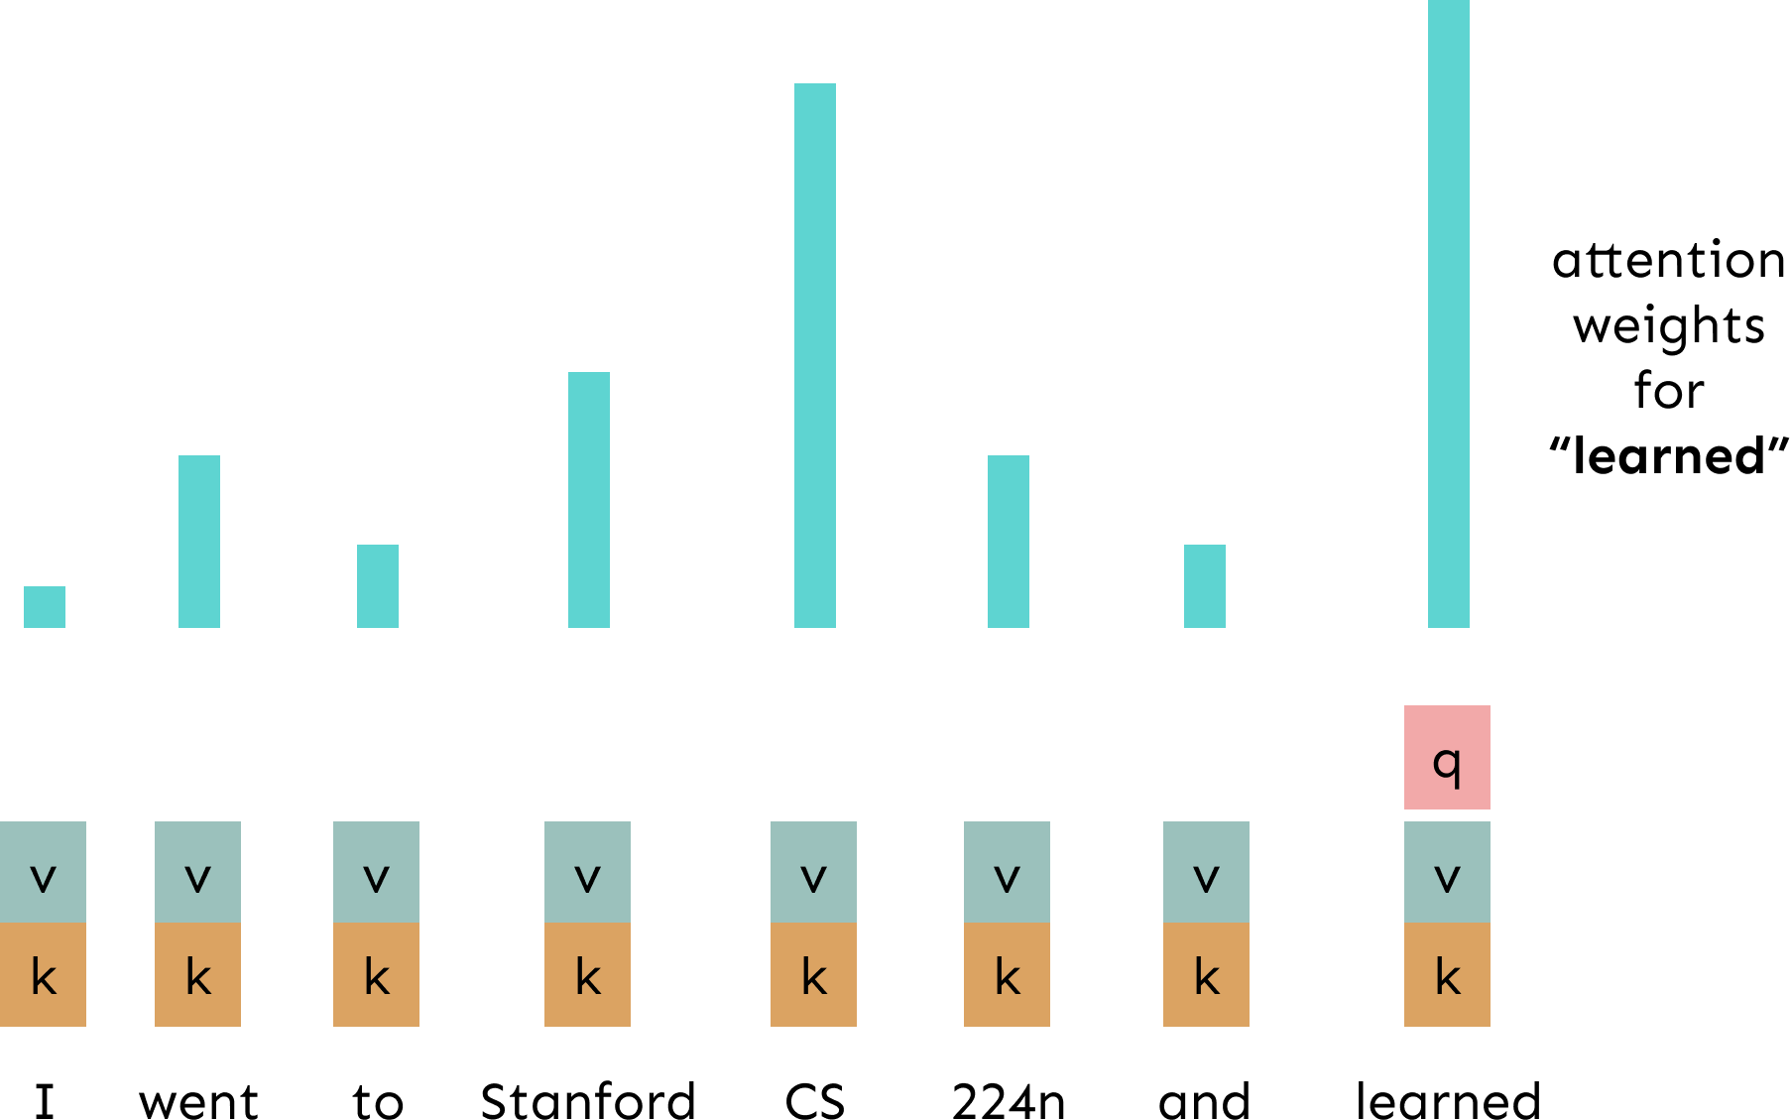
Self-Attention Hypothetical Example

Slide 7
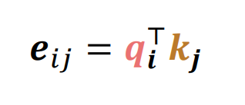
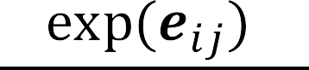

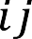
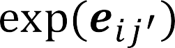
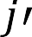

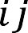

Self-Attention: keys, queries, values from the same sequence
Let 𝒘_{1:𝑛} be a sequence of words in vocabulary 𝑉, like Zuko made his uncle tea.
For each 𝒘_{𝑖} , let 𝒙_{𝑖} = 𝐸𝒘_{𝒊} where 𝐸 ∈ ℝ^{𝑑×|𝑉|} is an embedding matrix.
1. Transform each word embedding with weight matrices Q, K, V , each in ℝ^{𝑑×𝑑}
2. Compute pairwise similarities between keys and queries; normalize with softmax
3. Compute output for each word as weighted sum of values

Slide 8
Barriers and solutions for Self-Attention as a building block
Barriers
Doesn’t have an inherent
notion of order!
Solutions

Slide 9
Fixing the first self-attention problem: sequence order
Since self-attention doesn’t build in order information, we need to encode the order of the
sentence in our keys, queries, and values.
Consider representing each sequence index as a vector
𝒑_{𝑖} ∈ ℝ^{𝑑}, for 𝑖 ∈ {1,2, … , 𝑛} are position vectors
Don’t worry about what the 𝑝_{𝑖} are made of yet!
Easy to incorporate this info into our self-attention block: just add the 𝒑_{𝑖} to our inputs!
Recall that 𝒙_{𝑖} is the embedding of the word at index 𝑖. The positioned embedding is:
In deep self-attention networks, we do this at the first layer! You could concatenate them as well,
but people mostly just add…
𝒙’_{𝑖} = 𝒙_{𝑖} + 𝒑_{𝑖}

Slide 10
Position representation vectors learned from scratch
Learned absolute position representations: Let all 𝑝_{𝑖} be learnable parameters! Learn a matrix 𝒑 ∈ ℝ^{𝑑×𝑛}, and let each 𝒑_{𝑖} be a column of that matrix!
Pros:
Flexibility: each position gets to be learned to fit the data
Cons:
Definitely can’t extrapolate to indices outside 1, … , 𝑛.
Sometimes people try more flexible representations of position:
Relative linear position attention [Shaw et al., 2018]

Slide 11
Barriers and solutions for Self-Attention as a building block
Barriers
Doesn’t have an inherent
notion of order!
Solutions
Add position representations to the inputs
No Element wise nonlinearities for deep learning! It’s all just weighted averages

Slide 12
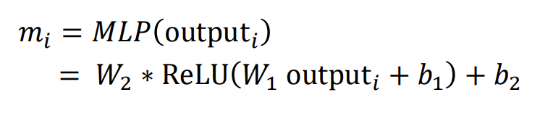
Adding nonlinearities in self-attention
Note that there are no element wise nonlinearities in self-attention; stacking more self-attention layers just re-averages value vectors.
Easy fix: add a feed-forward network
to post-process each output vector.
FF
FF
FF
self-attention
FF
…
FF
FF
FF
self-attention
FF
…
𝑤₂
chef
𝑤₃
who
𝑤_{𝑛}
food
𝑤₁
The
Intuition: the FF network processes the result of attention

Slide 13
Barriers and solutions for Self-Attention as a building block
Barriers
Doesn’t have an inherent
notion of order!
No nonlinearities for deep learning magic! It’s all just weighted averages
Need to ensure we don’t “look at the future” when predicting a sequence
Like in machine translation
Or language modeling
Solutions
Add position representations to the inputs
Easy fix: apply the same feedforward network to each self- attention output.

Slide 14
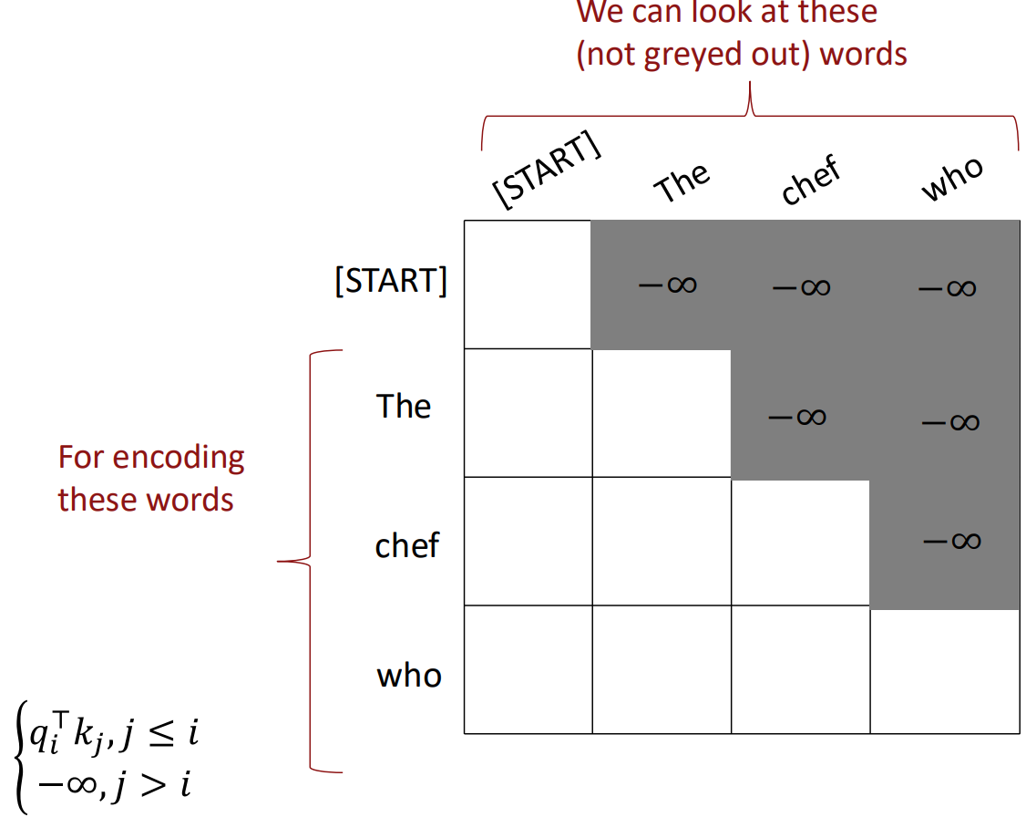
Masking the future in self-attention
To use self-attention in decoders, we need to ensure we can’t peek at the future.
At every timestep, we could change the set of keys and queries to include only past words. (Inefficient!)
To enable parallelization, we mask out attention to future words by setting attention scores to −∞.

Slide 15
Barriers and solutions for Self-Attention as a building block
Barriers
Doesn’t have an inherent
notion of order!
No nonlinearities for deep learning magic! It’s all just weighted averages
Need to ensure we don’t “look at the future” when predicting a sequence
Like in machine translation
Or language modeling
Solutions
Add position representations to the inputs
Easy fix: apply the same feedforward network to each self- attention output.
Mask out the future by artificially
setting attention weights to 0!

Slide 16
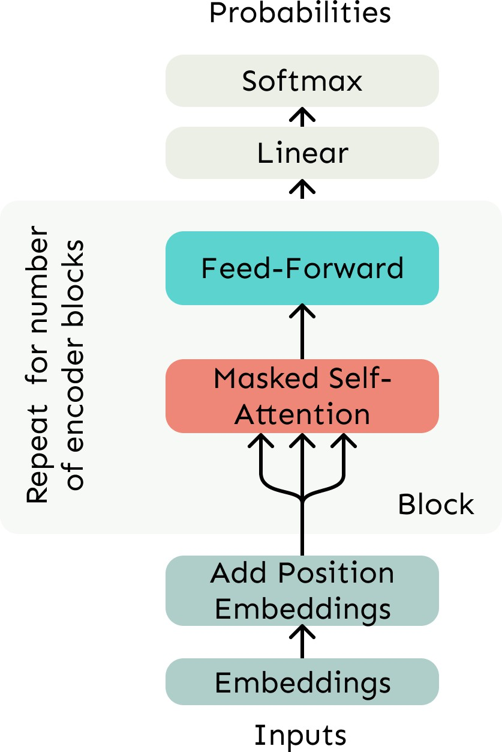
Necessities for a self-attention building block:
Self-attention:
the basis of the method.
Position representations:
Specify the sequence order, since self-attention
is an unordered function of its inputs.
Nonlinearities:
At the output of the self-attention block
Frequently implemented as a simple feed- forward network.
Masking:
In order to parallelize operations while not looking at the future.
Keeps information about the future from
“leaking” to the past.
19

Slide 17
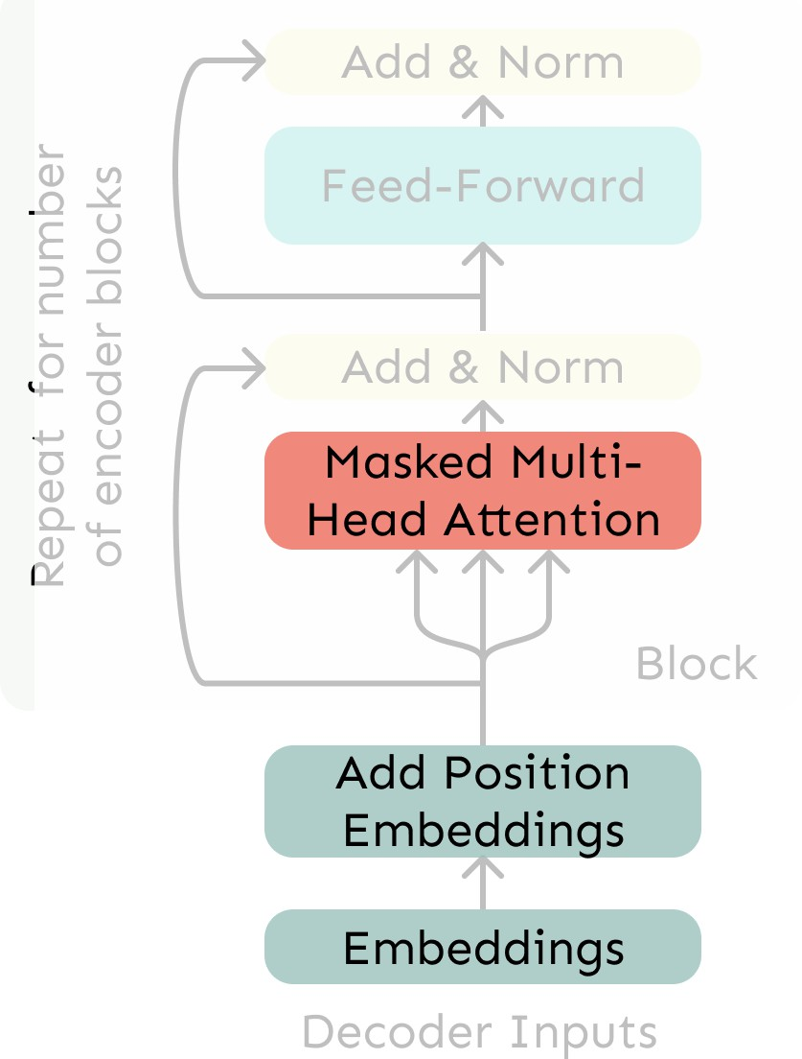
The Transformer Decoder
A Transformer decoder is how we’ll build systems like language models.
It’s a lot like our minimal self- attention architecture, but with a few more components.
The embeddings and position embeddings are identical.
We’ll next replace our self- attention with multi-head self- attention.
Transformer Decoder

Slide 18
Recall the Self-Attention Hypothetical Example

Slide 19
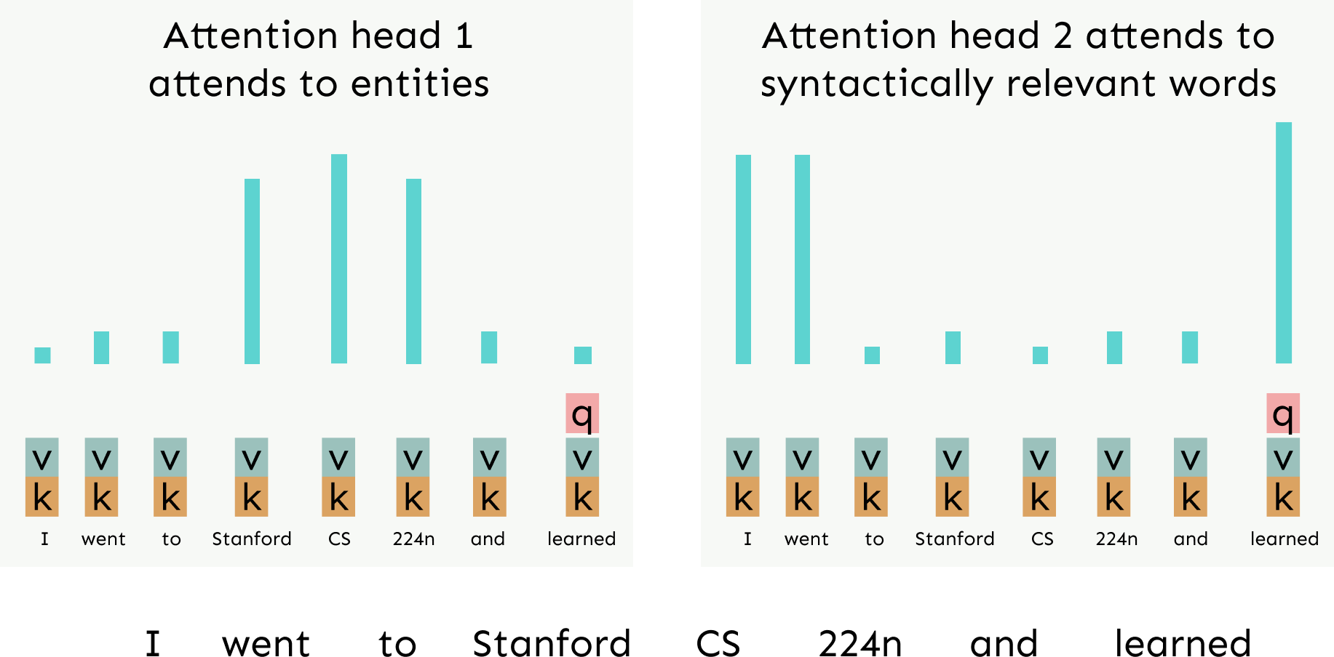
Hypothetical Example of Multi-Head Attention

Slide 20
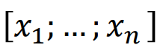
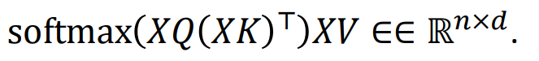
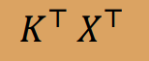
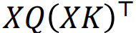
Sequence-Stacked form of Attention
Let’s look at how key-query-value attention is computed, in matrices.
Let 𝑋 = ∈ ℝ^{𝑛×𝑑} be the concatenation of input vectors.
First, note that 𝑋𝐾 ∈ ℝ^{𝑛×𝑑}, 𝑋𝑄 ∈ ℝ^{𝑛×𝑑}, 𝑋𝑉 ∈ ℝ^{𝑛×𝑑}.
The output is defined as output =
First, take the query-key dot products in one matrix multiplication:
All pairs of attention scores!
=
𝑋𝑄
𝑋𝑄𝐾^{𝖳} 𝑋^{𝖳}
∈ ℝ
𝑛×𝑛
Next, softmax, and compute the weighted average with another matrix multiplication.
softmax
𝑋𝑄𝐾^{𝖳} 𝑋^{𝖳}
=
𝑋𝑉
output ∈ ℝ^{𝑛×𝑑}

Slide 21
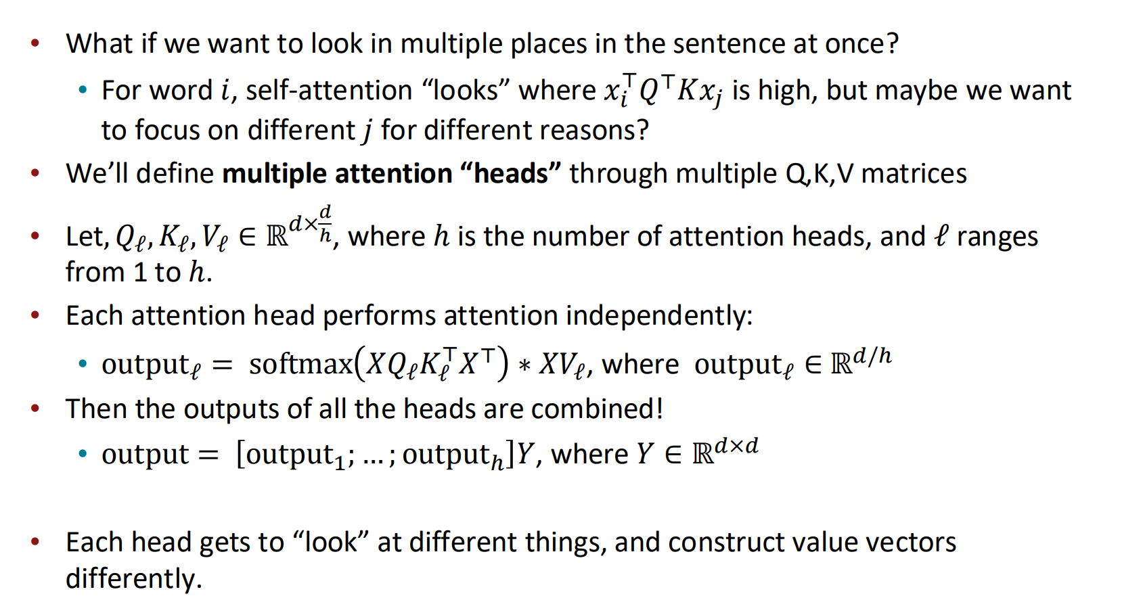
Multi-headed attention
25

Slide 22
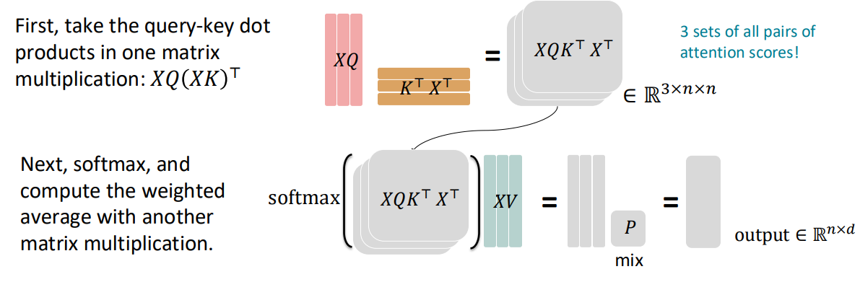
Multi-head self-attention is computationally efficient
Even though we compute ℎ many attention heads, it’s not really more costly.
We compute 𝑋𝑄 ∈ ℝ^{𝑛×𝑑}, and then reshape to ℝ^{𝑛×ℎ×𝑑/ℎ}. (Likewise for 𝑋𝐾, 𝑋𝑉.)
Then we transpose to ℝ^{ℎ×𝑛×𝑑/ℎ}; now the head axis is like a batch axis.
Almost everything else is identical, and the matrices are the same sizes.
26

Slide 23
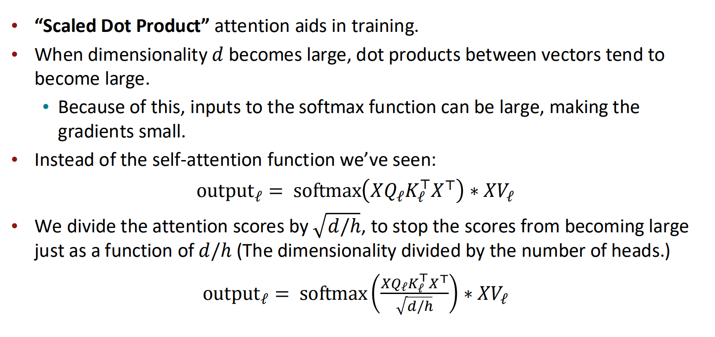
Scaled Dot Product [Vaswani et al., 2017]

Slide 24

The Transformer Decoder
Now that we’ve replaced self- attention with multi-head self- attention, we’ll go through two optimization tricks that end up being :
Residual Connections
Layer Normalization
In most Transformer diagrams, these are often written together as “Add & Norm”
Transformer Decoder

Slide 25
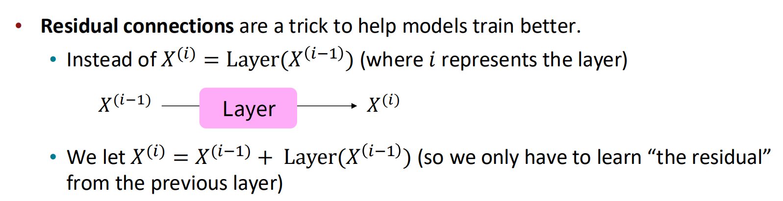
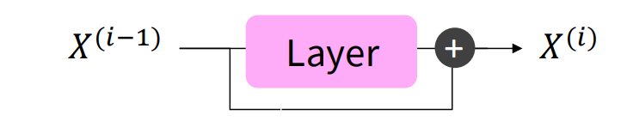
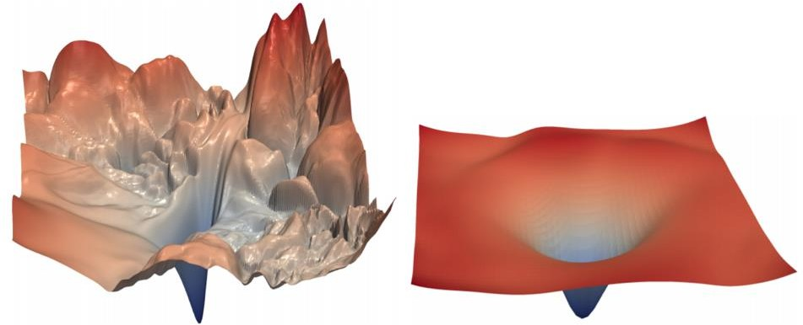
The Transformer Encoder: Residual connections [He et al., 2016]
Gradient is great through the residual
connection; it’s 1!
Bias towards the identity function!
[no residuals] [residuals]
[Loss landscape visualization, Li et al., 2018, on a ResNet]
29

Slide 26
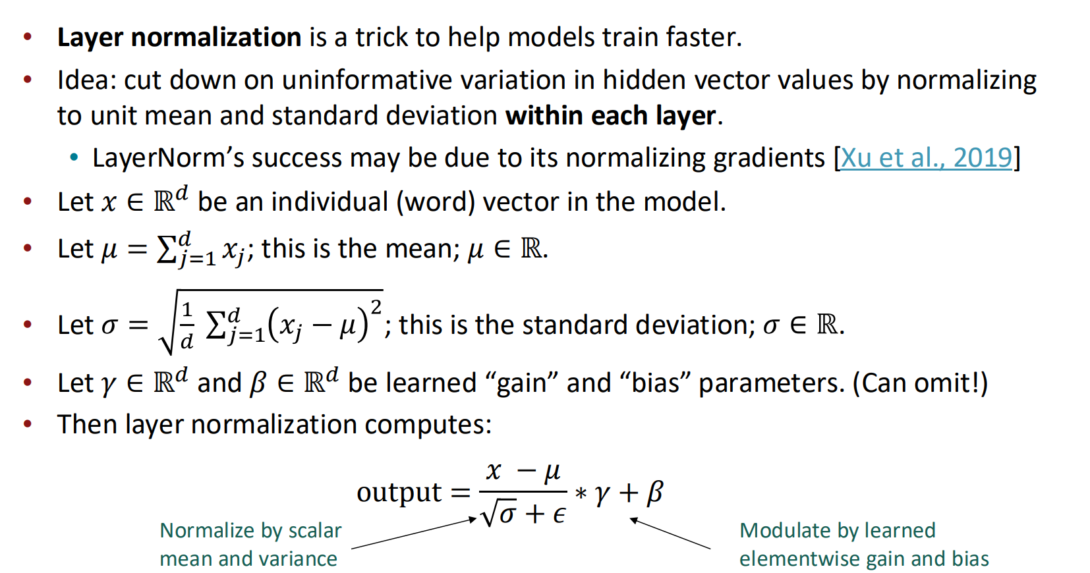
The Transformer Encoder: Layer normalization [Ba et al., 2016]
30

Slide 27
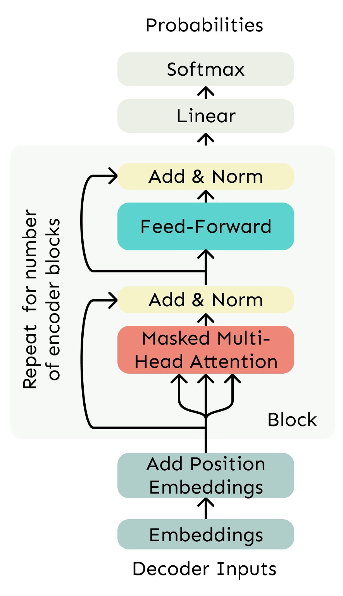
The Transformer Decoder
The Transformer Decoder is a stack of Transformer Decoder Blocks.
Each Block consists of:
Self-attention
Add & Norm
Feed-Forward
Add & Norm
That’s it! We’ve gone through
the Transformer Decoder.
Transformer Decoder

Slide 28
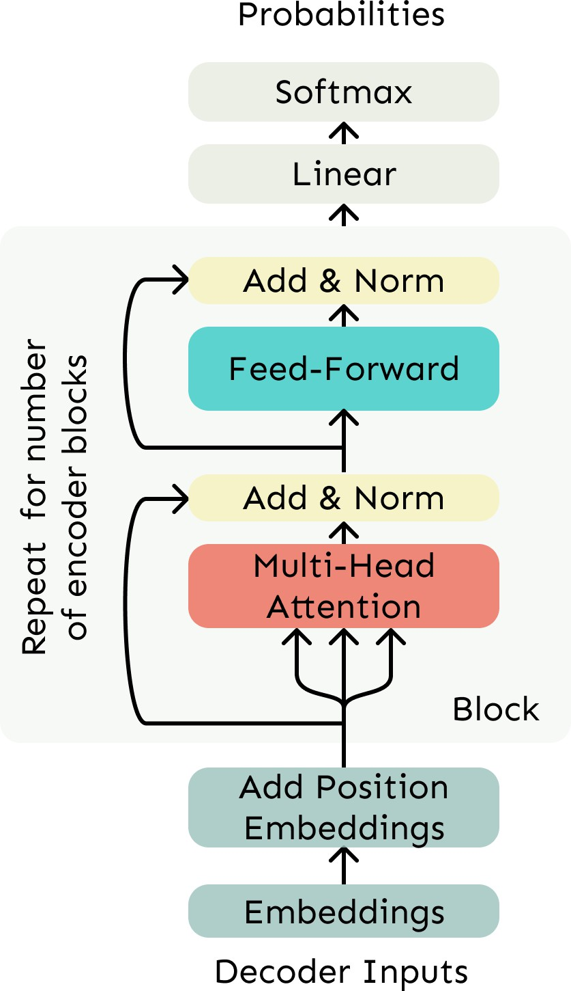

The Transformer Encoder
The Transformer Decoder constraints to unidirectional context, as for language models.
What if we want bidirectional context, like in a bidirectional RNN?
This is the Transformer Encoder. The only difference is that we remove the masking in the self-attention.
No Masking!
Transformer Decoder

Slide 29
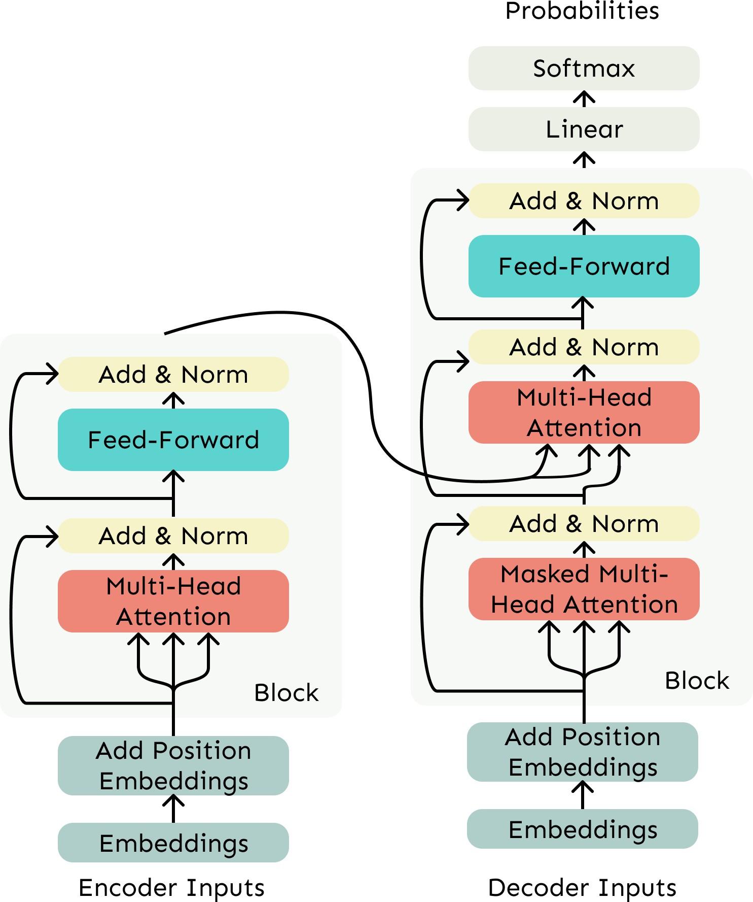
The Transformer Encoder-Decoder
Recall that in machine translation, we processed the source sentence with a bidirectional model and generated the target with a unidirectional model.
For this kind of seq2seq format, we often use a Transformer Encoder-Decoder.
We use a normal Transformer Encoder.
Our Transformer Decoder is modified to perform cross- attention to the output of the Encoder.
33

Slide 30
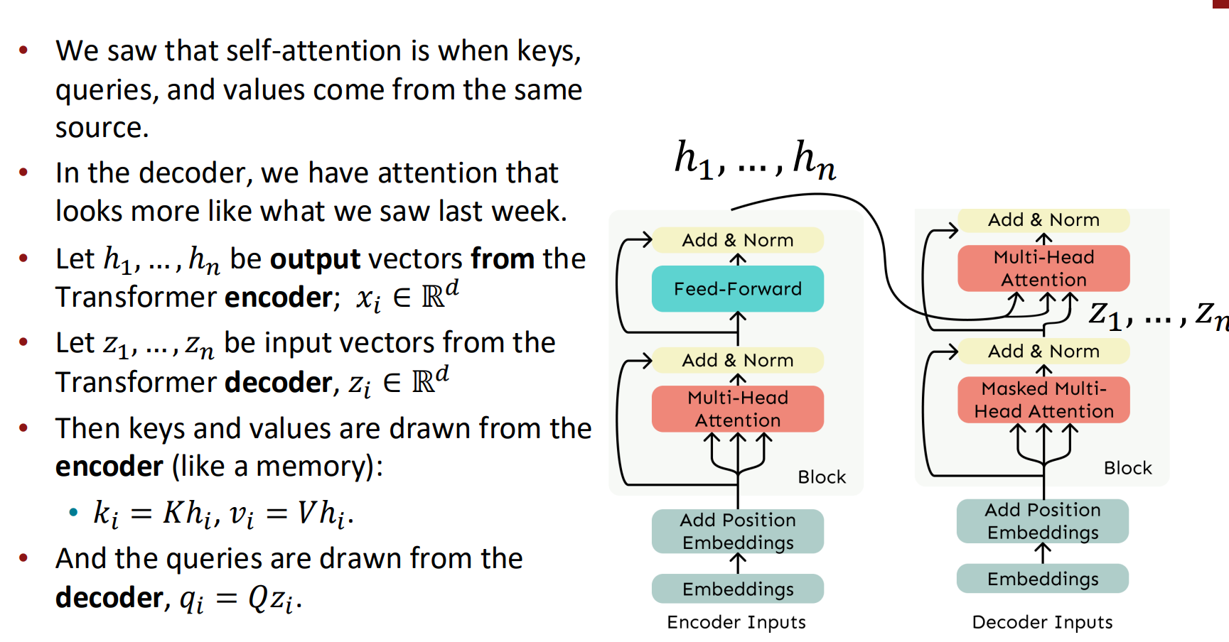
Cross-attention (details)

Slide 31
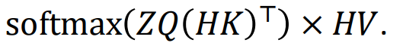
Cross-attention (details)
Let’s look at how cross-attention is computed, in matrices.
Let H = ℎ₁; … ; ℎ_{𝑇}
Let Z = 𝑧₁; … ; 𝑧_{𝑇}
∈ ℝ^{𝑇×𝑑} be the concatenation of encoder vectors.
∈ ℝ^{𝑇×𝑑} be the concatenation of decoder vectors.
The output is defined as output =
First, take the query-key dot products in one matrix
All pairs of attention scores!
=
𝑍𝑄
_{𝐾}𝖳 _{𝐻}𝖳
𝑍𝑄𝐾^{𝖳} 𝐻^{𝖳}
multiplication: 𝑍𝑄 𝐻𝐾
𝖳
∈ ℝ
𝑇×𝑇
Next, softmax, and compute the weighted average with another matrix multiplication.
softmax
𝑍𝑄𝐾^{𝖳} 𝐻^{𝖳}
=
𝐻𝑉
output ∈ ℝ^{𝑇×𝑑}

Slide 32
Outline
From recurrence (RNN) to attention-based NLP models
Introducing the Transformer model
Great results with Transformers
Drawbacks and variants of Transformers

Slide 33
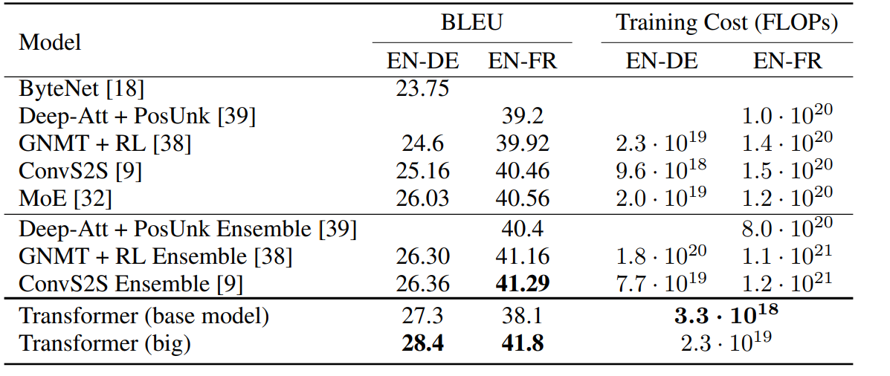
Great Results with Transformers
First, Machine Translation from the original Transformers paper!
Not just better Machine Also more efficient to
Translation BLEU scores train!
[Test sets: WMT 2014 English-German and English-French]
[Vaswani et al., 2017]

Slide 34
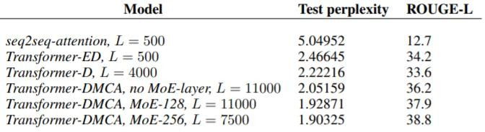
Great Results with Transformers
Next, document generation!
The old standard
Transformers all the way down.
[Liu et al., 2018]; WikiSum dataset

Slide 35
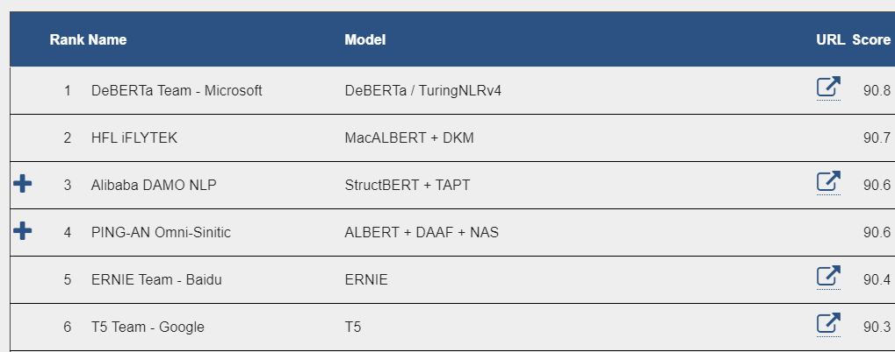

Great Results with Transformers
Before too long, most Transformers results also included pretraining, a method we’ll
go over next.
Transformers’ parallelizability allows for efficient pretraining, and have made them
the de-facto standard.
On this popular aggregate
benchmark, for example:
All top models are Transformer (and pretraining)-based.
More results Thursday when we discuss pretraining.
39
[Liu et al., 2018]

Slide 36
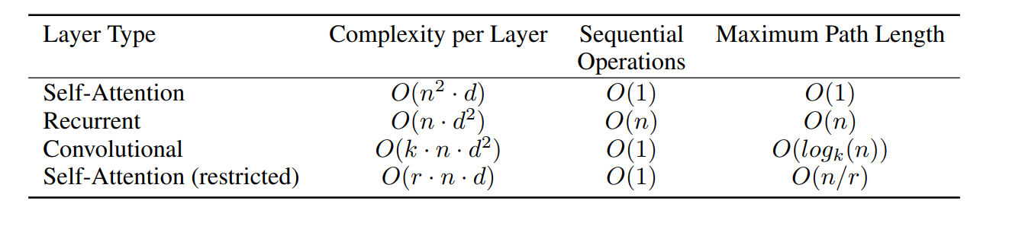
What would we like to fix about the Transformer?
Training instabilities (Pre vs Post norm)
Quadratic compute in self-attention :
Computing all pairs of interactions means our computation grows
quadratically with the sequence length!
For recurrent models, it only grew linearly!

Slide 37
Quadratic computation as a function of sequence length
One of the benefits of self-attention over recurrence was that it’s highly
parallelizable.
However, its total number of operations grows as 𝑂 (𝑛²𝑑) , where 𝑛 is the sequence length, and 𝑑 is the dimensionality.
_{𝐾}𝖳 _{𝑋}𝖳
= 𝑋𝑄𝐾^{𝖳} 𝑋^{𝖳}
Need to compute all pairs of interactions!
𝑂 𝑛²𝑑
𝑋𝑄
∈ ℝ
𝑛×𝑛
Think of 𝑑 as around 𝟏, 𝟎𝟎𝟎 (though for large language models it’s much larger!).
So, for a single (shortish) sentence, 𝑛 ≤ 30; 𝑛² ≤ 𝟗𝟎𝟎.
In practice, we set a bound like 𝑛 = 512.
But what if we’d like 𝒏 ≥ 𝟓𝟎, 𝟎𝟎𝟎? For example, to work on long documents?

Slide 38
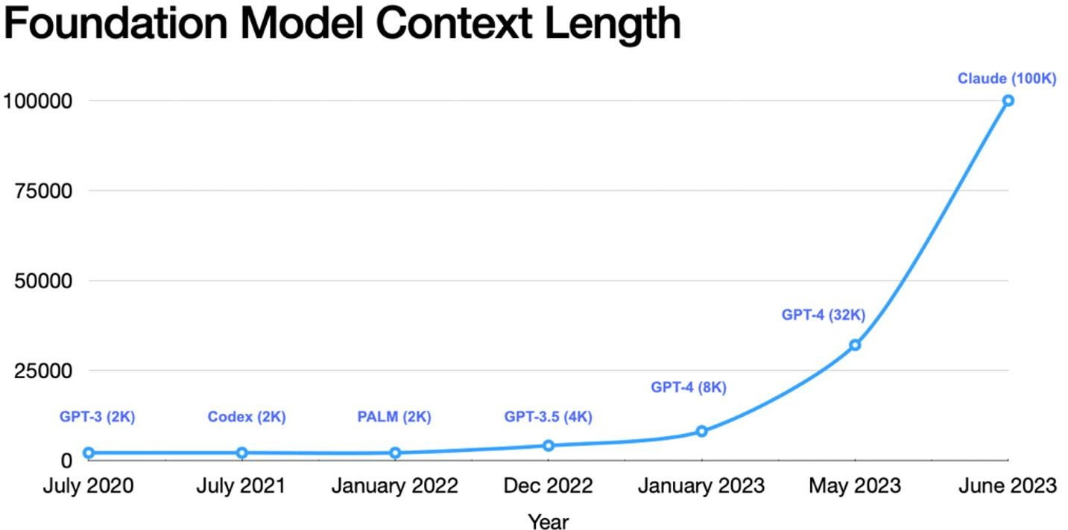
Do we even need to remove the quadratic cost of attention?
As Transformers grow larger, a larger and larger percent of compute is outside the self-attention portion, despite the quadratic cost.
In practice, production Transformer language models use quadratic cost attention
The cheaper methods tend not to work as well at scale.
Systems optimizations work well (Flash attention – Jun 2022)

Slide 39
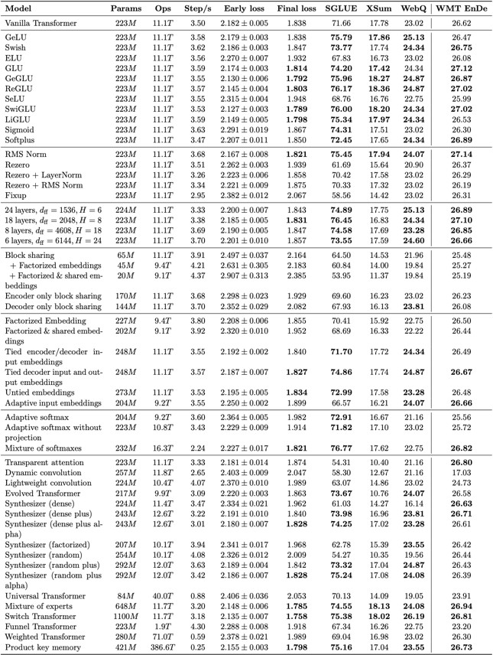
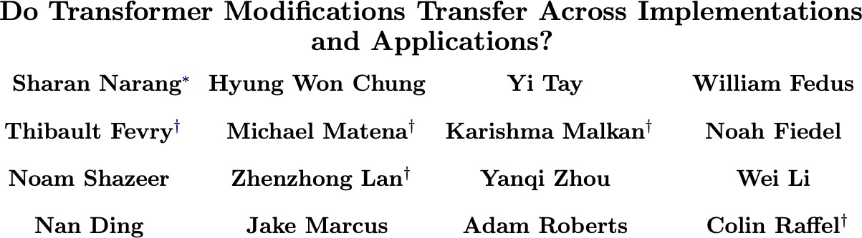
Do Transformer Modifications Transfer?
"Surprisingly, we find that most modifications do not meaningfully improve performance."

Slide 40
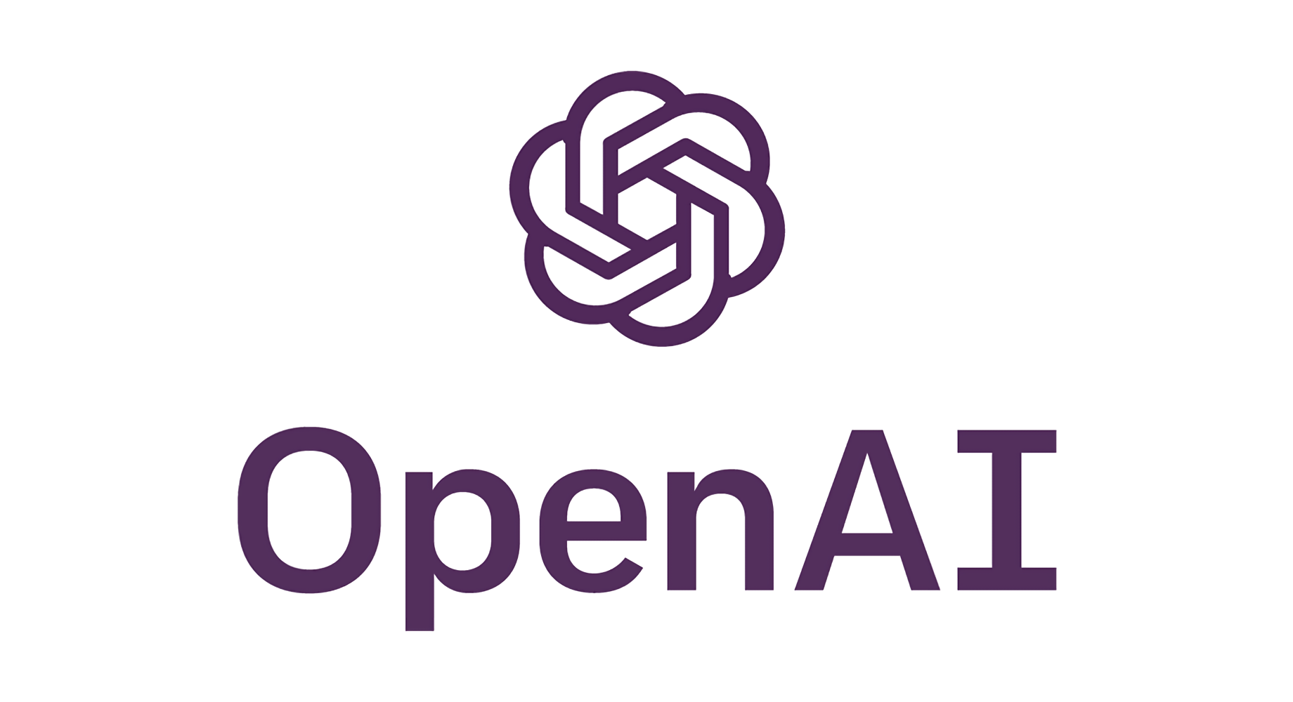
GPT: Generative Pre-trained Transformer

Slide 41
GPT
Unidirectional: trained to predict next word in a sentence
GPT-1 - 110M parameters
GPT-2 1.5B parameters
GPT-3 175B parameters

Slide 42
Generative Pretrained Transformer (GPT) [Radford et al., 2018]
2018’s GPT was a big success in pretraining a decoder!
Transformer decoder with 12 layers, 117M parameters.
768-dimensional hidden states, 3072-dimensional feed-forward hidden layers.
Byte-pair encoding with 40,000 merges
Trained on BooksCorpus: over 7000 unique books.
Contains long spans of contiguous text, for learning long-distance dependencies.
The acronym “GPT” never showed up in the original paper; it could stand for “Generative PreTraining” or “Generative Pretrained Transformer”
50
[Devlin et al., 2018]

Slide 43
Generative Pretrained Transformer (GPT) [Radford et al., 2018]
How do we format inputs to our decoder for finetuning tasks?
Natural Language Inference: Label pairs of sentences as entailing/contradictory/neutral
Premise: The man is in the doorway
Hypothesis: The person is near the door
entailment
Radford et al., 2018 evaluate on natural language inference.
Here’s roughly how the input was formatted, as a sequence of tokens for the decoder.
[START] The man is in the doorway [DELIM] The person is near the door [EXTRACT] The linear classifier is applied to the representation of the [EXTRACT] token.

Slide 44
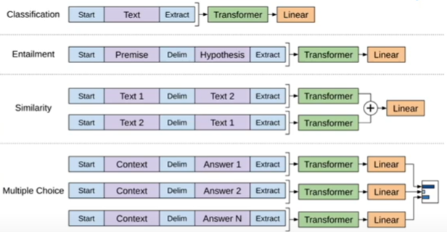
GPT-1 Key Concepts
Bottleneck: Lack of labeled data
2-step training process: (“semi-supervised”)
Generative pre-training on unlabeled data; “self-supervised” learning
Discriminative fine-tuning on labeled data; supervised

Slide 45
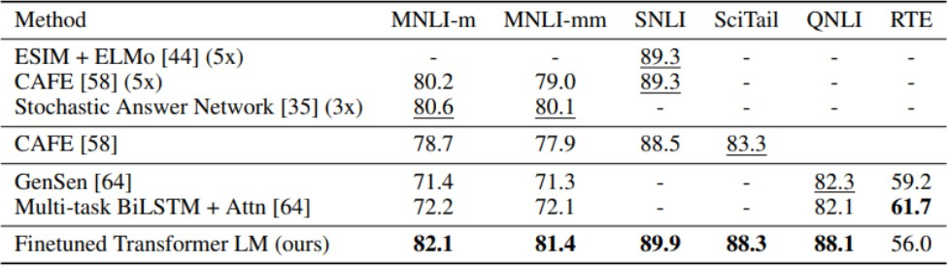
Generative Pretrained Transformer (GPT) [Radford et al., 2018]
GPT results on various natural language inference datasets.

Slide 46
GPT-2 Key Concepts
Compared to GPT-1
Larger model
Larger unlabeled dataset
No fine-tuning (zero-shot transfer instead)

Slide 47
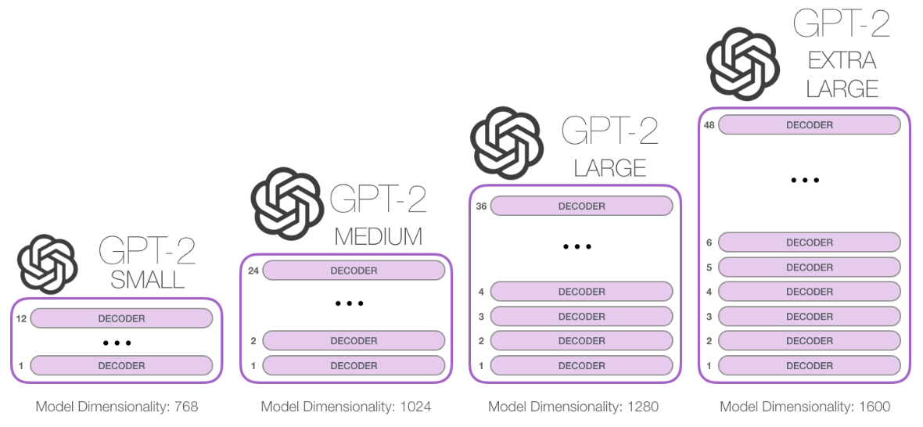
GPT-2
Unlike BERT which uses the Transformer Encoder blocks, GPT stacks the Transformer Decoder.
GPT-2 is auto-regressive, BERT is not. BERT dropped the auto-regression in order to incorporate the context on both sides of a word.

Slide 48
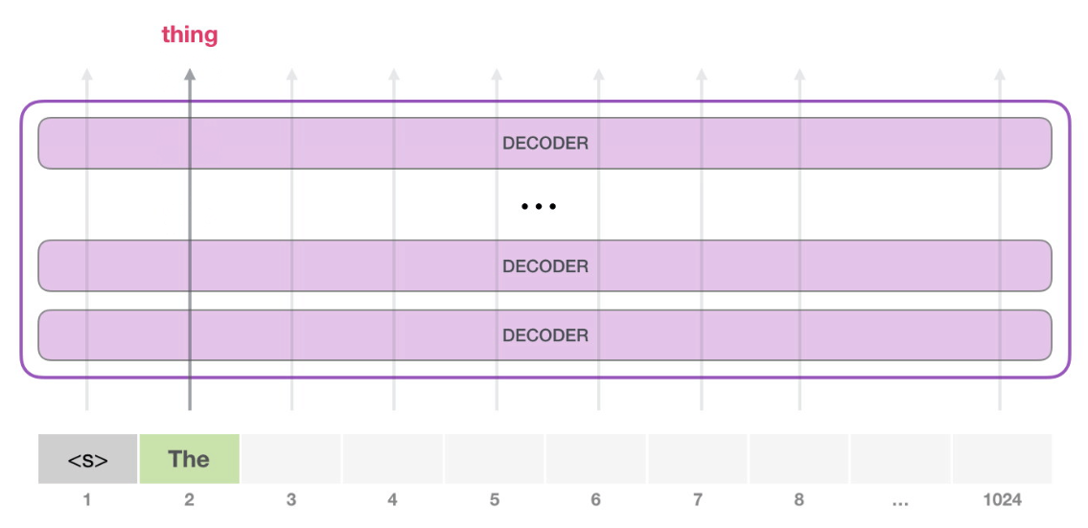
GPT-2
http://jalammar.github.io/illustrated-gpt2/

Slide 49
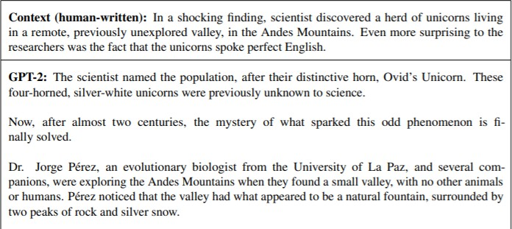
Increasingly convincing generations (GPT2) [Radford et al., 2018]
We mentioned how pretrained decoders can be used in their capacities as language models. GPT-2, a larger version (1.5B) of GPT trained on more data, was shown to produce relatively convincing samples of natural language.

Slide 50
GPT-3
Overall, similar to GPT-2
More parameters - 175B vs 1.5B
Double the context size (2048 from 1024)
Larger word embeddings (12.8k instead of 1.6k)
Attention pattern from Sparse Transformer

Slide 51
GPT-3, In-context learning, and very large models
So far, we’ve interacted with pretrained models in two ways:
Sample from the distributions they define (maybe providing a prompt)
Fine-tune them on a task we care about, and take their predictions.
Very large language models seem to perform some kind of learning without gradient steps simply from examples you provide within their contexts.
GPT-3 is the canonical example of this. The largest T5 model had 11 billion parameters.
GPT-3 has 175 billion parameters.

Slide 52
GPT-3, In-context learning, and very large models
Very large language models seem to perform some kind of learning without gradient steps simply from examples you provide within their contexts.
The in-context examples seem to specify the task to be performed, and the conditional distribution mocks performing the task to a certain extent.
Input (prefix within a single Transformer decoder context):
thanks -> merci hello -> bonjour mint -> menthe
otter ->
Output (conditional generations):
loutre…

Slide 53
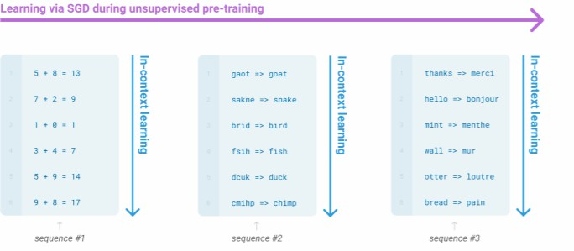
GPT-3, In-context learning, and very large models
Very large language models seem to perform some kind of learning without gradient steps simply from examples you provide within their contexts.

Slide 54
The byte-pair encoding algorithm
Subword modeling in NLP encompasses a wide range of methods for reasoning about
structure below the word level. (Parts of words, characters, bytes.)
The dominant modern paradigm is to learn a vocabulary of parts of words (subword tokens).
At training and testing time, each word is split into a sequence of known subwords.
Byte-pair encoding is a simple, effective strategy for defining a subword vocabulary.
Start with a vocabulary containing only characters and an “end-of-word” symbol.
Using a corpus of text, find the most common adjacent characters “a,b”; add “ab” as a subword.
Replace instances of the character pair with the new subword; repeat until desired vocab size.
Originally used in NLP for machine translation; now a similar method (WordPiece) is used in pretrained models.
[Sennrich et al., 2016, Wu et al., 2016]
64

Slide 55
Word structure and subword models
Common words end up being a part of the subword vocabulary, while rarer words are split
into (sometimes intuitive, sometimes not) components.
In the worst case, words are split into as many subwords as they have characters.
word
vocab mapping
hat learn
taa## aaa## sty la## ern## Transformer## ify
embedding
hat learn
taaaaasty laern
🡪
🡪
🡪
🡪
Common words
Variations
misspellings
novel items
Transformerify 🡪

